Slide 2
Unit 2: Virtualization (7hrs)
Introduction
  1.1 Virtualization Technologies: Virtual Machines, Hypervisors (Type 1 & Type 2)
  1.2 Overview of Containerization and Kubernetes
Virtual Machines (VM)
  2.1 Virtual Machine Management and Configuration
Virtualization Level
  3.1 Hardware, Software, Operating System, Data and Networking
Virtual Private Cloud (VPC)
Virtual Private Network (VPN)
DNS Service and Cloud Network
Multihoming

Slide 3
Virtualization
Virtualization is creating a virtual version of something rather than a physical one.
In computing, software simulates hardware functionality, allowing multiple operating systems or applications to run on a single physical machine simultaneously.
Virtualization is foundational in DevOps and cloud computing because it enables efficient resource use, isolation, scalability, and automation.
This practice maximizes a physical machine’s capacity by distributing its resources between multiple users and environments.

Slide 4
Virtualization
Virtualization is a technology that creates a virtual (software-based) version of computing resources, such as servers, storage, networks, and desktops.
It abstracts physical hardware resources into virtual resources that can be easily managed, modified, or scaled according to application needs.

Slide 5
Virtualization
Each VM has an operating system and acts as an independent computer even though it runs on a portion of the physical device.
A virtual machine mimics all components of a computer; including:
  CPU
  RAM
  Storage
  Networks
With virtualization, a piece of hardware can host numerous VM configuratiuon simultaneously without performance issues.

Slide 6
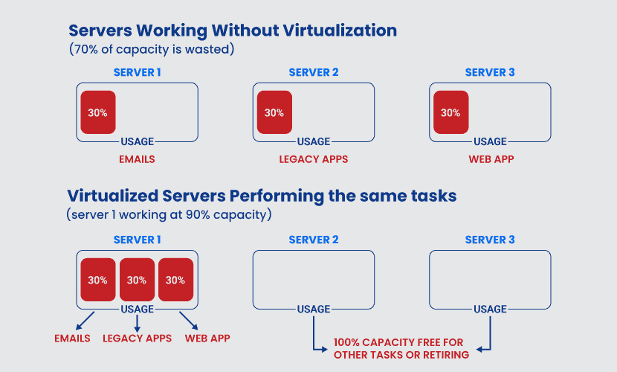
Virtualization

Slide 7
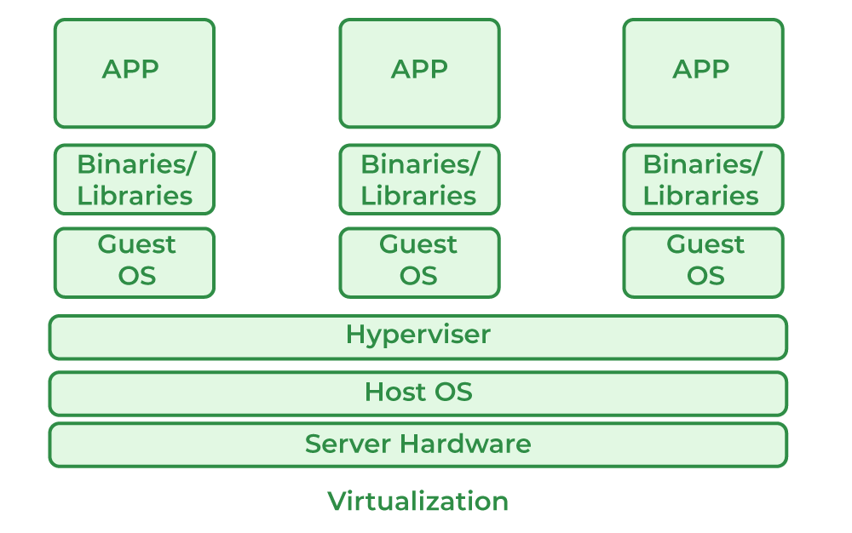
Virtualization

Slide 8
Benefits of Virtualization
Resource Efficiency: Maximizes resource utilization by allowing multiple virtual machines (VMs) to run on a single hardware system.
Isolation: Each VM operates independently, improving security and stability and minimizing risks of conflicts.
Scalability: Quickly scales resources up or down based on demand.
Flexibility: Enables quick provisioning and deployment of applications and environments.

Slide 9
Types of Virtualization
Virtualization comes in various types, each serving a different purpose within IT environments:
  Server Virtualization
  Desktop Virtualization
  Application Virtualization
  Network Virtualization
  Storage Virtualization
  Data Virtualization
  OS Virtualization

Slide 10
Server Virtualization
Definition: Server virtualization divides a physical server into multiple isolated virtual servers, known as Virtual Machines (VMs).
Use Cases: Commonly used to optimize physical server usage, reduce costs, and run different operating systems and applications on a single physical machine.
Examples of Tools: VMware, Hyper-V, KVM.

Slide 11
Desktop Virtualization
Definition: Desktop virtualization allows the creation of virtual desktops that users can access remotely on any device.
Use Cases: Provides secure and flexible desktop access, especially useful for remote work and IT troubleshooting.
Examples of Tools: VMware Horizon, Citrix Virtual Apps and Desktops.

Slide 12
Application Virtualization
Definition: Application virtualization separates an application from the underlying OS, allowing it to run in an isolated environment.
Use Cases: Helps avoid compatibility issues by packaging applications for use on different OS versions or configurations.
Examples of Tools: Citrix XenApp, Microsoft App-V.

Slide 13
Network Virtualization
Definition: Network virtualization abstracts network resources like switches, routers, and firewalls into virtual network components.
Use Cases: Enhances network flexibility, security, and scalability in cloud and data center environments.
Examples of Tools: VMware NSX, Cisco ACI, Open vSwitch.

Slide 14
Storage Virtualization
Definition: Storage virtualization pools physical storage from multiple devices into a single virtual storage unit.
Use Cases: Simplifies storage management, improves scalability, and optimizes performance.
Examples of Tools: IBM Spectrum Virtualize, NetApp ONTAP.

Slide 15
Data Virtualization
Definition: Data virtualization aggregates data from different sources without physically moving it.
Use Cases: Enables real-time data access and analysis across different storage systems or databases.
Examples of Tools: Denodo, Red Hat Data Virtualization.

Slide 16
OS Virtualization
Definition: OS virtualization creates isolated user-space instances called containers that run on a single OS kernel.
Use Cases: Used in DevOps for lightweight, efficient deployment of applications without the need for full VMs.
Examples of Tools: Docker, LXC, Kubernetes (for orchestrating containers).

Slide 17
Virtual Machines
A Virtual Machine is an emulation of a computer system.
Each VM contains:
  Virtual CPU
  Virtual Memory
  Virtual Storage
  Guest Operating System
Multiple VMs can run on a single physical server.

Slide 18
Hypervisors in Virtualization
A hypervisor, also known as a Virtual Machine Monitor (VMM), is software that creates and manages VMs on a host machine.
Hypervisors take physical resources and divide them up so that virtual environments can use them.
There are two types of hypervisors:
Type 1 (Bare-Metal Hypervisor)
Type 2 (Hosted Hypervisor)

Slide 19
Hypervisors in Virtualization
Type 1 (Bare-Metal Hypervisor): Runs directly on the physical hardware, offering high performance and direct hardware access.
  Examples: VMware ESXi, Microsoft Hyper-V, KVM.
Type 2 (Hosted Hypervisor): Runs on an operating system as an application, making it less performant but more flexible for development environments.
  Examples: VMware Workstation, VirtualBox.

Slide 20
Containerization
Unlike VMs, containers share the host OS kernel but isolate applications at the process level.
Key features:
  Lightweight and Fast startup
  Portable
  Ideal for microservices
Example technologies: Docker, Podman, containerd

Slide 21
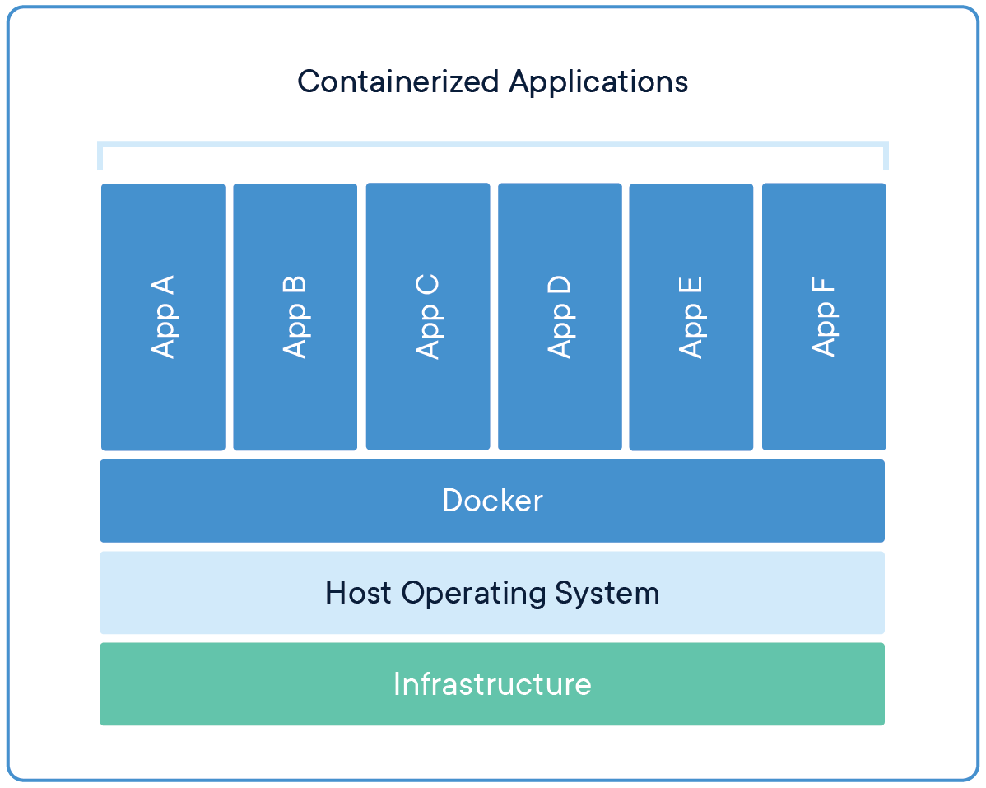
Containerization

Slide 22
Containerization
Containerization allows applications to run in isolated, lightweight environments called containers.
Unlike virtual machines, containers don’t need a full operating system — they share the host OS kernel.
Think of a container as:
  A small isolated room inside a big house, sharing the same walls (OS), but keeping its own items (app + dependencies).

Slide 23
Why Containerization Exists
Before containers:
  Apps had different dependencies
  “Works on my machine” problems
  Heavy VMs slowed deployments
  It took minutes to start a VM
Containers solve all these by providing:
  Fast startup
  Lightweight environments
  Consistent behavior everywhere

Slide 24
How Containerization Works Internally
1. You Write a Dockerfile
  This file defines your app, Its dependencies, Base image and Commands to run
Example:
  FROM node:18
  COPY . /app
  CMD ["node", "server.js"]

Slide 25
How Containerization Works Internally
2. Docker Creates an Image
  An image is a blueprint (template):
    Application code
    Libraries
    Packages
    Runtime environment
  Images are made of layers.
  If something changes, only that layer updates (saves space).

Slide 26
How Containerization Works Internally
3. A Container is Started from the Image
  A container = running instance of the image.
  It has:
    Its own file system
    Its own process tree
    Its own networking
    Its own resource limits
  But shares the host OS kernel.

Slide 27
How Containerization Works Internally
4. Linux Kernel Provides Isolation
Two main technologies make containerization possible:
(A) Control Groups (cgroups) – Manage Resource Limits
cgroups limit:
  CPU usage, Memory, Network bandwidth, IO
  This prevents one container from eating all resources.
(B) Namespaces – Provide Isolation
Namespaces isolate: Process IDs, File system, Hostnames, Users, Networking
Each container sees only its own world.
Example:
  Container A process IDs start at 1
  Container B also starts at 1
  Host sees all processes

Slide 28
How Containerization Works Internally
5. Union File System Enables Layered Images
Docker images use UnionFS (like overlay2). It allows:
  Base image reuse
  Copy-on-write
  Very fast updates
Example layers:
  Layer 1: Ubuntu
  Layer 2: Python installed
  Layer 3: App code
  Layer 4: Configuration

Slide 29
How Containerization Works Internally
6. Containers Use a Virtual Network
Docker creates:
  docker0 bridge
  Virtual Ethernet pairs (veth)
  NAT rules
Container gets its own IP address.
Containers can:
  Talk to each other
  Be exposed to the internet
  Connect to Cloud load balancers

Slide 30
VMs vs Containers
Virtual Machines
Have full OS
Heavy
Slow to boot
Strong isolation
Containers
Share host OS
Lightweight
Start in seconds
Perfect for microservices

Slide 31
Kubernetes
Kubernetes (K8s) is an open-source container orchestration platform used to automate the deployment, scaling, load balancing, healing, and management of containerized applications.
Think of Kubernetes as the “operating system for the cloud data center.”

Slide 32
Why use Kubernetes?
Containers alone (Docker) are good for packaging applications, but managing many containers manually becomes impossible.
Kubernetes solves all the pain points of running containers at scale.

Slide 33
Why use Kubernetes?
⚠️ Problems Without Kubernetes
If you use Docker alone:
  You must start/stop containers manually
  If a container crashes → app goes down
  You must handle your own load balancing
  You must deploy updates manually
  You must monitor capacity and scale yourself
  You must manage networking for all containers
  Hard to run across multiple nodes/servers
As soon as you go beyond 3–4 containers → chaos begins.

Slide 34
What Kubernetes does to you?
1. Auto-Healing
If a container crashes → Kubernetes restarts it
If a node (server) goes down → workloads move to another node
Keeps applications always running.

Slide 35
What Kubernetes does to you?
2. Auto-Scaling
Kubernetes automatically increases/decreases containers based on:
  CPU usage
  Memory usage
  User traffic
Example: e-commerce site automatically scales during Dashain/Tihar sale.

Slide 36
What Kubernetes does to you?
3. Automated Deployment & Rollbacks
For updates:
  Kubernetes deploys new version
  Tests if healthy
  Rolls back automatically if problem
No downtime updates → CI/CD friendly.

Slide 37
What Kubernetes does to you?
4. Service Discovery & Load Balancing
Kubernetes provides:
  Internal DNS
  Automatic load balancing for services
  Stable service IPs even if containers change
Apps communicate easily even when containers replace each other.

Slide 38
What Kubernetes does to you?
5. Multi-Node Cluster Management
Kubernetes groups many servers into one cluster:
  Master/Control plane → brain
  Worker nodes → run containers
Kubernetes spreads containers across nodes for reliability.

Slide 39
What Kubernetes does to you?
6. Config & Secret Management
Handles:
  API keys
  Passwords
  Environment variables
  Config files
Secure, centralized configuration management.

Slide 40
What Kubernetes does to you?
7. Runs Anywhere (Cloud, On-Premises, Hybrid)
Kubernetes works on:
  AWS EKS
  Google GKE
  Azure AKS
  Bare-metal servers
  VMware
  OpenStack
  Minikube for local labs
Most cloud-native apps today rely on Kubernetes.

Slide 41
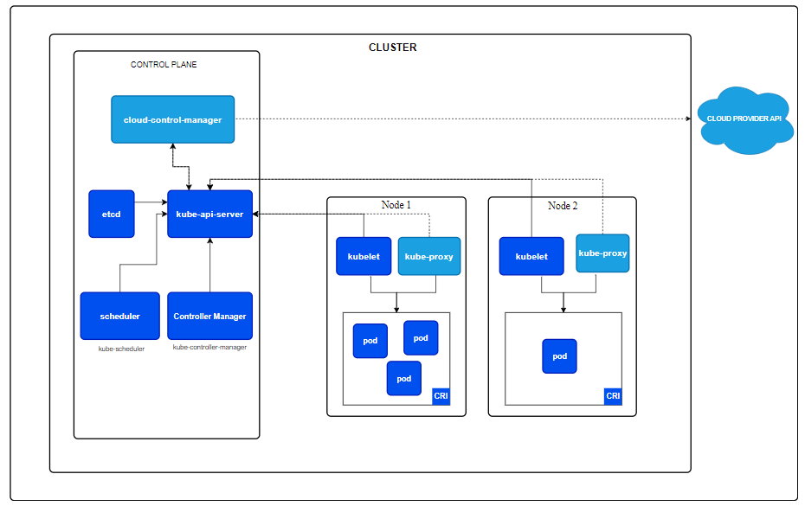
Kubernetes Architecture

Slide 42
How Kubernetes Uses Containers
Kubernetes does:
Scheduling containers on nodes
Restarting failed containers
Scaling replicas
Networking
Load balancing
A container is always inside a Pod in Kubernetes.

Slide 43
VPC
A Virtual Private Cloud (VPC) is a logically isolated virtual network in the cloud where you can run your resources (VMs, databases, containers) securely.
It acts like your own private data center inside the cloud, just like a mini data center where you control the IP ranges, subnets, routing, firewalls, gateways, and connectivity.
Think of it as:
“Your personal secure LAN inside AWS/Azure/GCP.”

Slide 44
Key Features of VPC
Custom IP Address ranges (CIDR blocks)
Subnets (public and private)
Routing tables
Internet Gateway (IGW)
NAT Gateway
Security Groups (firewall rules)
Network ACLs (subnet-level security)
VPC Peering (connect two VPCs)
Transit Gateway (for multiple VPCs)

Slide 45
VPC
Cloud providers serve millions of customers.
All hardware is shared, but logically isolated.
VPC provides the isolation.
Without a VPC, your instances would be on shared networks — increasing risk and reducing control.

Slide 46
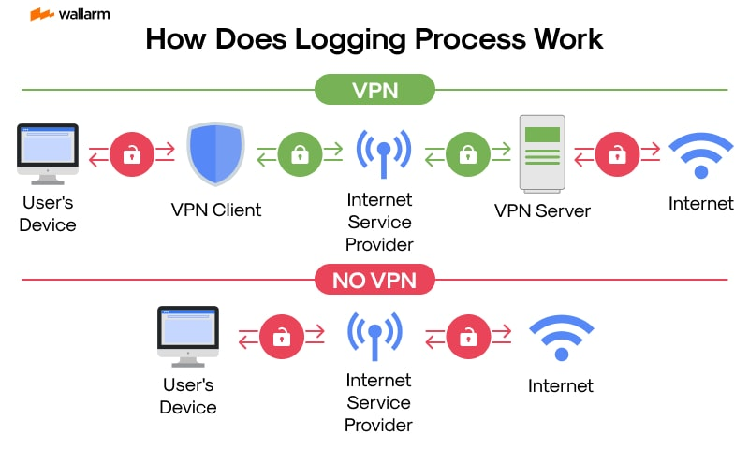
VPN

Slide 47
VPN
A VPN (Virtual Private Network) is a secure tunnel created over a public network (the Internet) to connect:
  On-premises data centers to the cloud
  Remote users to a cloud environment
  Two cloud networks together
VPN ensures:
  Confidentiality (encryption)
  Integrity
  Authentication

Slide 48
Step-by-Step Working of a VPN
1. You Connect to the Internet
  Your device → ISP → Internet
  Normally, everything is visible:
    Your IP address
    The websites you visit
    Data you send

Slide 49
Step-by-Step Working of a VPN
2. You Turn ON the VPN
  You select a VPN server (e.g., Singapore, USA, Nepal).
  Your device and the VPN server:
    Perform a handshake
    Agree on encryption keys
    Establish a secure tunnel

Slide 50
Step-by-Step Working of a VPN
3. A Secure Tunnel is Formed
  This tunnel uses strong encryption protocols like:
    OpenVPN
    IPSec
    WireGuard
    L2TP/IPSec
  This tunnel prevents:
    Snooping
    Man-in-the-middle attacks
    Data tampering

Slide 51
Step-by-Step Working of a VPN
3. A Secure Tunnel is Formed
  This tunnel uses strong encryption protocols like:
    OpenVPN
    IPSec
    WireGuard
    L2TP/IPSec
  This tunnel prevents:
    Snooping
    Man-in-the-middle attacks
    Data tampering

Slide 52
Step-by-Step Working of a VPN
4. Your Data is Encrypted Before Leaving Your Device
  Example:
  You send a password or message.
  VPN encrypts it using AES-256 or ChaCha20 encryption.
  Even if someone intercepts it, they see:
    xJ23%#jdASD8237!@# ... (nonsense)

Slide 53
Step-by-Step Working of a VPN
5. Data Travels Through the Secure Tunnel
  Your ISP sees only:
    You are connected to a VPN
    Amount of data
  It cannot see:
    Websites you opened
    Content of data
    Search queries

Slide 54
Step-by-Step Working of a VPN
6. VPN Server Decrypts the Data
  VPN server → removes encryption → forwards request to the Internet.
  Example:
    You request www.google.com
    VPN server sends the request to Google on your behalf
  So Google sees the VPN server’s IP address, not yours.

Slide 55
Step-by-Step Working of a VPN
7. Response Returns Through the Tunnel
  Google → VPN Server → encrypted tunnel → your device
  Your device decrypts it.

Slide 56
Step-by-Step Working of a VPN
In Simple Terms
WITHOUT VPN:
Your device — ISP — Internet
(Everyone can see your activity)
WITH VPN:
Your device — Encrypted Tunnel — VPN Server — Internet
(ISP & attackers see nothing)

Slide 57
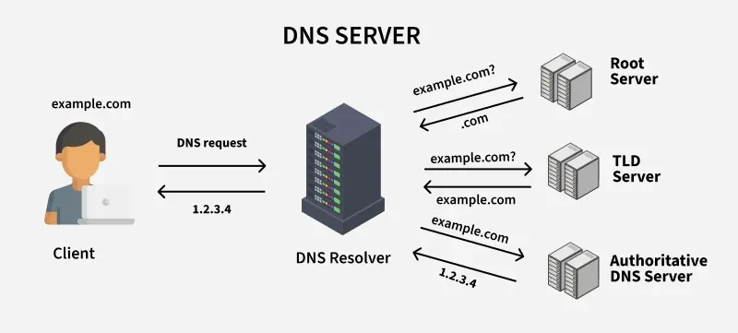
DNS Service and Cloud Network

Slide 58
DNS Service
DNS (Domain Name System) converts domain names into IP addresses.
Example: www.example.com → 13.52.14.233
Cloud providers offer managed DNS services.
Features
  Domain registration
  DNS zones & records (A, AAAA, CNAME, MX, TXT)
  Health checks
  Traffic routing (geolocation, latency-based)
  Load balancing (using DNS policy)

Slide 59
How DNS Works?
Initial request: When you type a website address into your browser, your device sends a request to a DNS server to find the corresponding IP address.
DNS lookup: The DNS server performs a "lookup" to find the correct IP address for the domain name.
Translation: Once the IP address is found, the DNS server returns it to your device.
Accessing the site: Your browser then uses this IP address to connect to the website's server and load the page.

Slide 60
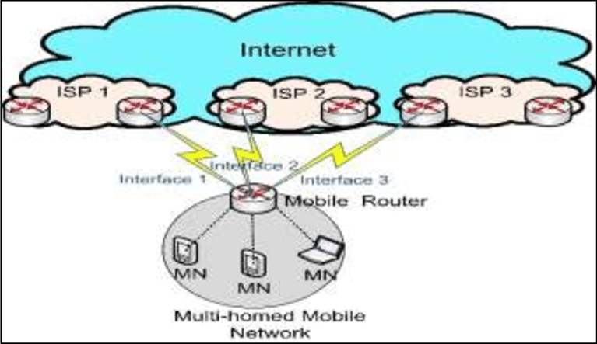
Multihoming

Slide 61
Multihoming
Multihoming is connecting a network or host to multiple networks or ISPs simultaneously for reliability and performance.
In cloud computing, multihoming is used to ensure:
  High availability
  Redundancy
  Traffic failover
  Load balancing across multiple links
  Better performance

Slide 62
Examples of Multihoming
Cloud + On-Premises + Another Cloud
  AWS VPC connected to
  → local office (via VPN or Direct Connect)
  → Azure VNet (via inter-cloud VPN)
Multiple ISPs
  Organization connects to 2 or more Internet providers.
  If ISP A fails → traffic routes through ISP B.
Multi-Region or Multi-AZ Setup
  Applications deployed in multiple cloud regions.
Multiple Network Interfaces on a VM
  One VM has 2 NICs connected to different subnets or VPCs.

Slide 63
Multihoming
Prevents downtime
Improves network performance
Ensures continuous connectivity
Avoids vendor lock-in
Enables hybrid and multi-cloud architectures

Slide 64
How multihoming works?
A multihomed system has:
  Multiple network interfaces (NICs)
  Multiple IP addresses
  Multiple gateways or ISPs
Traffic can go through any available link.

Slide 65
How multihoming works?
A Simple Example
If ISP1 stops working, server automatically switches to ISP2.
Interface | ISP/Network | IP
eth0 | ISP 1 | 192.168.1.10
eth1 | ISP 2 | 10.0.0.5

Slide 66
End of
Unit 2

Slide 67
Storage in Cloud Computing

